Slide 1
Mario Nakazawa Companion and Quest Mod for Fallout: New Vegas
By: Logan Owens

Slide 2
Overview:
What would Mario be like as a companion in a video game?
Explain Mario’s presence with a short and simple quest.
An easy-to-understand head start for new players.
Entertainment for new and returning players alike.

Slide 3
Usage: Who Would Use This and Why?
The who: people looking for a semi-serious starter follower who can also assist a new player and level up with them. This is also for anyone who wants a brief but entertaining quest to play through.
The why: newer players often find themselves without much help in the early game while encountering several challenging battles. The companion is to help with the battles while the quest will help a new player level up so they can be better skilled to be in battle.

Slide 4
What Was Used to Create This?
Fallout: New Vegas
Garden of Eden Creation Kit (GECK)
New Vegas Script Extender (xNVSE)
New Vegas Anti Crash (NVAC)
New Vegas Tick Fix (NVTF)
Mod Limit Fix

Slide 5
Features:
Quest with four different endings.
Companion w/several functions.
Skill checks in quest dialogue.
New locations.

Slide 6

Design Process:

Slide 7
Design Process cont.
Iterative, very iterative.
Create a piece of the project in the GECK, check it in game, apply fixes if necessary.

Slide 8
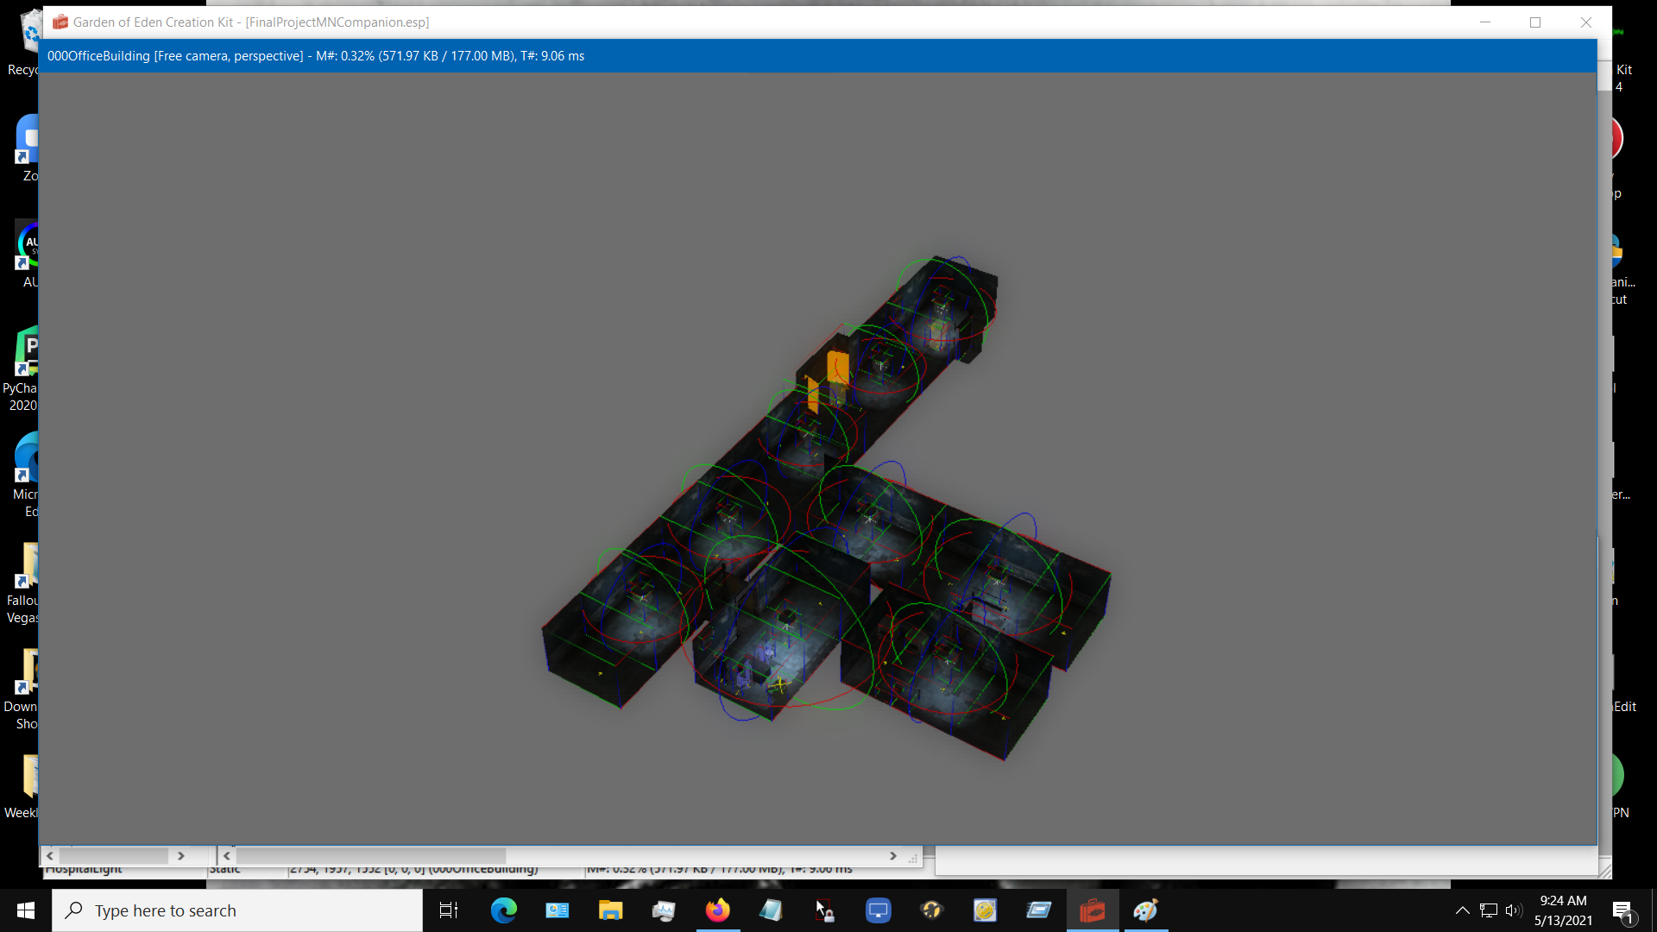

Slide 9
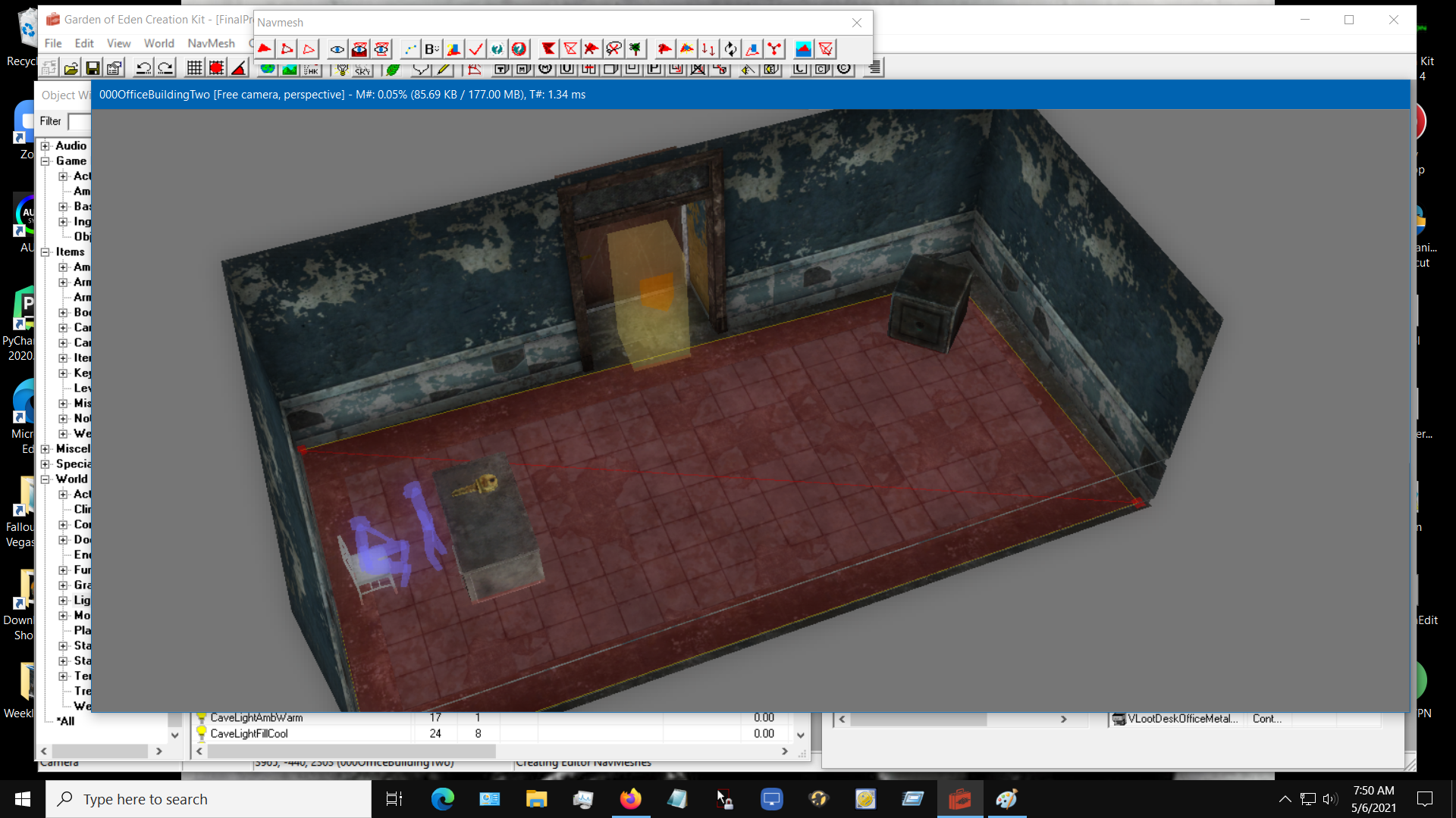

Slide 10
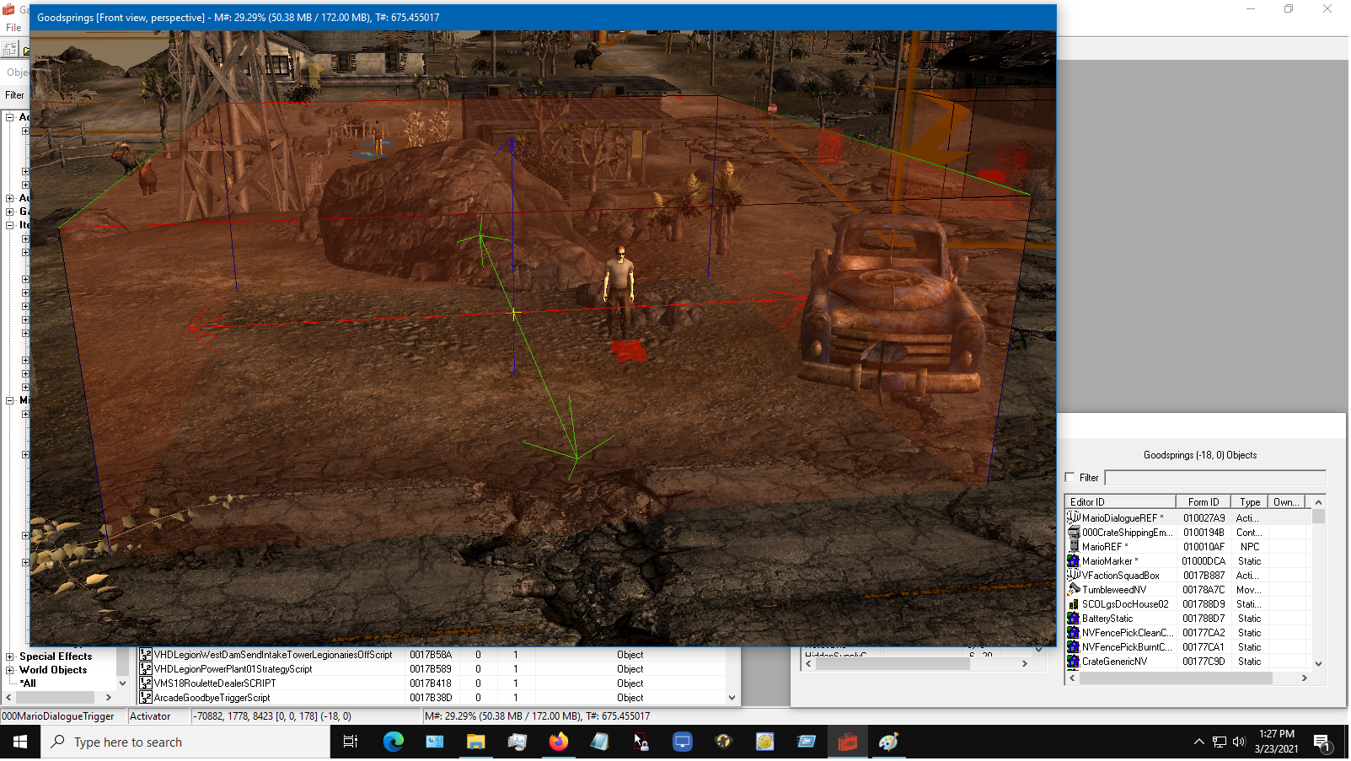

Slide 11
Testing:
Unit testing: creating a system and making sure it works as intended (it doesn’t).
Ad Hoc testing: how are other people interacting with my project when they use it?

Slide 12
Testing Results: Unit Testing
Due to the nature of the tool, I couldn’t make certain mistakes (scripts refusing to save if not correct).
Very easy to find certain bugs since you had to interact with them (dialogue showing up when it shouldn’t).

Slide 13
Testing Results: Ad Hoc
Both testers tried to kill Mario, but he is essential (doesn’t die, only falls unconscious).
Both testers were killed by Mario (working as intended).
Quest was easy to navigate.
Lockpick skill for safe was too high (the skill check was lowered).
Both testers missed the optional objectives.

Slide 14
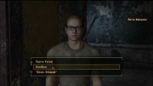
Demo:

Slide 15
What Have I Learned:
More advanced usage of the GECK.
Self-sufficiency while problem solving.
Time Management.
Self-motivation.
Being comfortable learning at my own pace.
How to enjoy working with complex systems.
How to manage frustration when “roadblocking.”

Slide 16
Sources Used:
https://store.steampowered.com/app/22380/Fallout_New_Vegas/
https://geckwiki.com/index.php/Garden_of_Eden_Creation_Kit
https://github.com/xNVSE/NVSE
https://www.nexusmods.com/newvegas/mods/53635
https://www.nexusmods.com/newvegas/mods/66537
https://www.nexusmods.com/newvegas/mods/68714
https://knowyourmeme.com/photos/1809295-patrick-star

